Slide 1
Immersive Python Workshop
Day 3
Data Visualization
1/9/2026

Slide 2
Overall Goals of this Data Visualization Session
See examples of what’s possible
Learn benefits of scripting data visualization tasks
Learn how to read documentation about using Python packages
Get familiar with the process of developing Python scripts locally

Slide 3
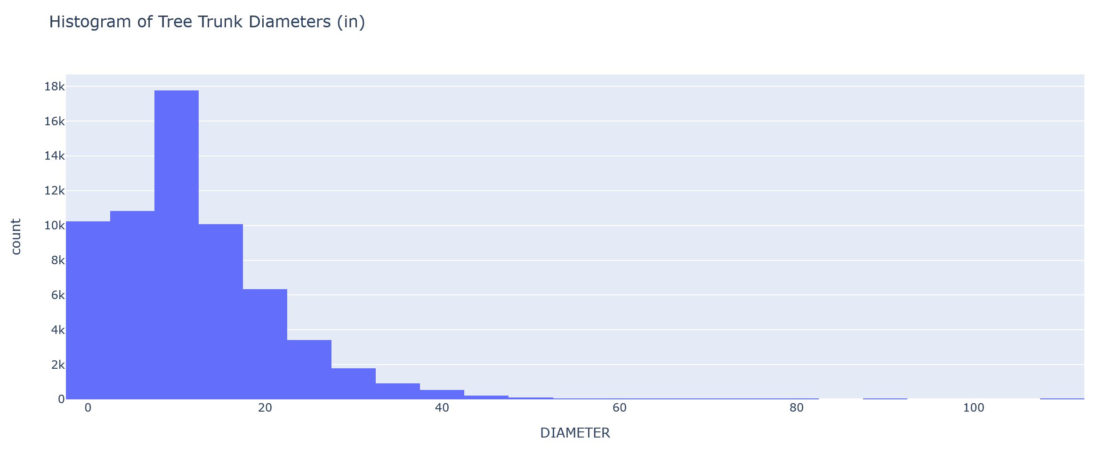
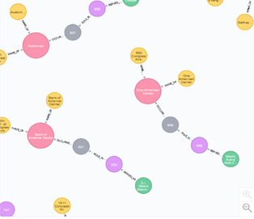
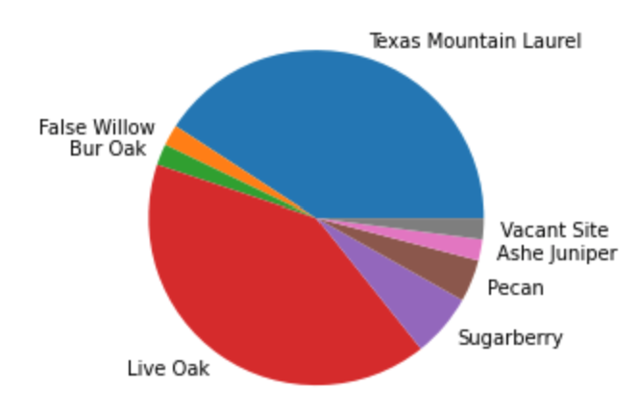
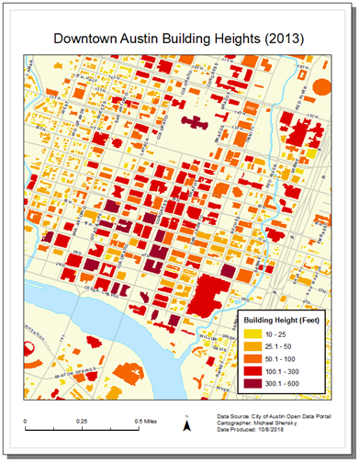
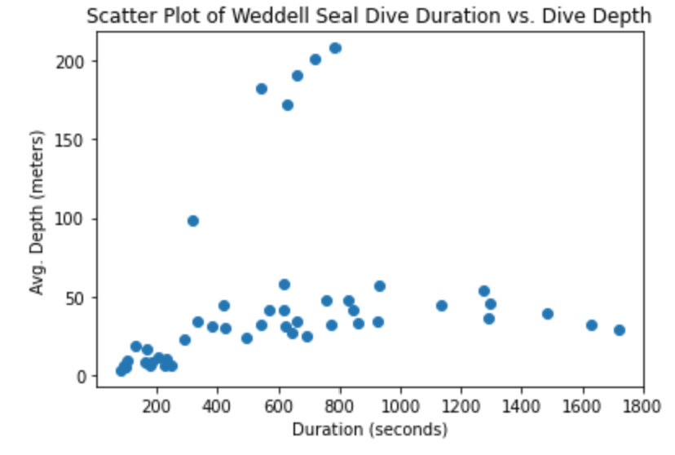
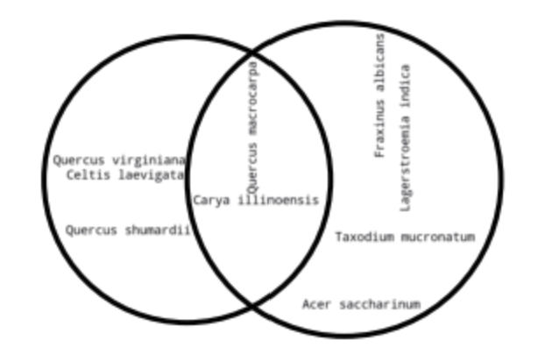
What is Data Visualization?
Graphically representing data to facilitate communication of information
Visualizations often take the form of charts, graphs, maps, and diagrams
Effective data visualization is both an art and science
Can be difficult and time consuming when:
Datasets are large and complicated
Datasets are updated frequently
Large numbers of visualizations need to be created
Multiple styles of a visualization product are required for different audiences

Slide 4
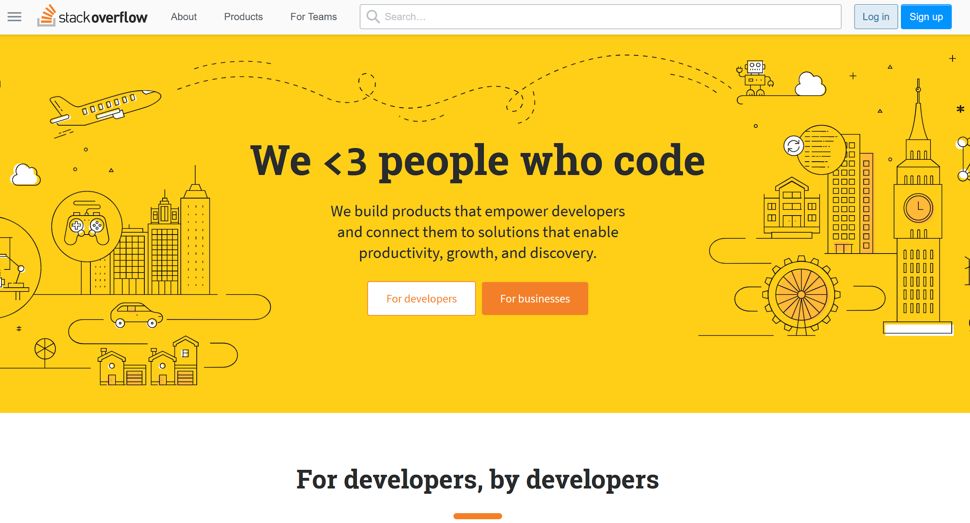
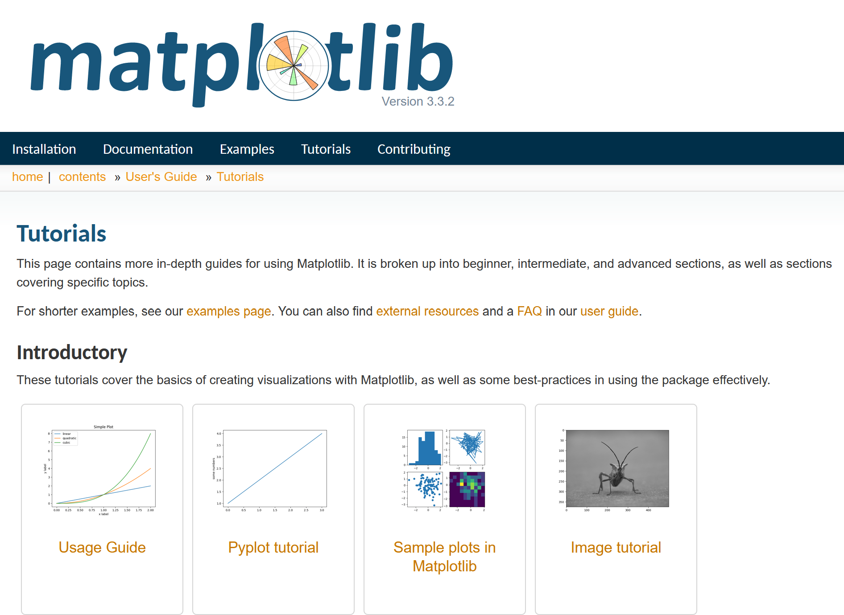
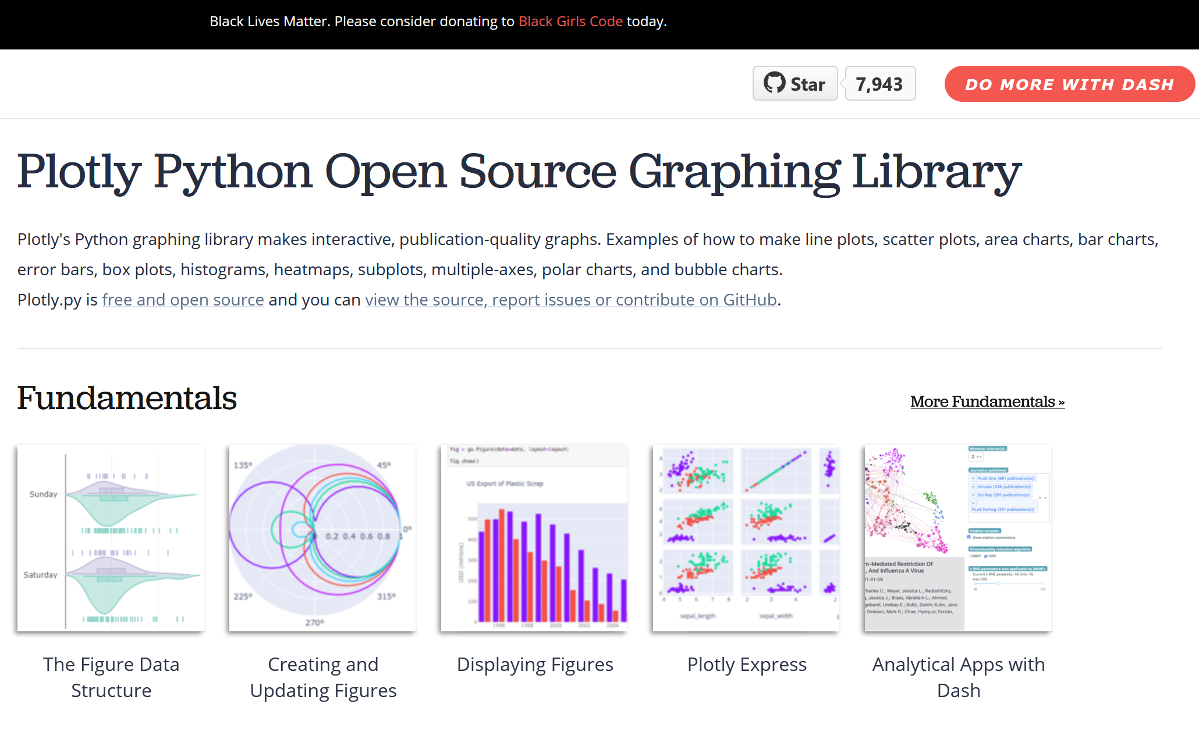
Python Data Visualization Resources
Matplotlib Documentation (https://matplotlib.org/3.3.2/tutorials/index.html)
Altair Documentation (https://altair-viz.github.io/user_guide/data.html)
Plotly Documentation (https://plotly.com/python/)

Slide 5





Choosing a Data Visualization Library
Factors to Consider
Static vs. Interactive visualizations
Support for niche visualization types (e.g. maps, networks)
API complexity
API level of control
Popularity
API documentation

Slide 6


Packages for Tabular Data and Data Visualization
Commonly used packages
Pandas
Polars

Slide 7

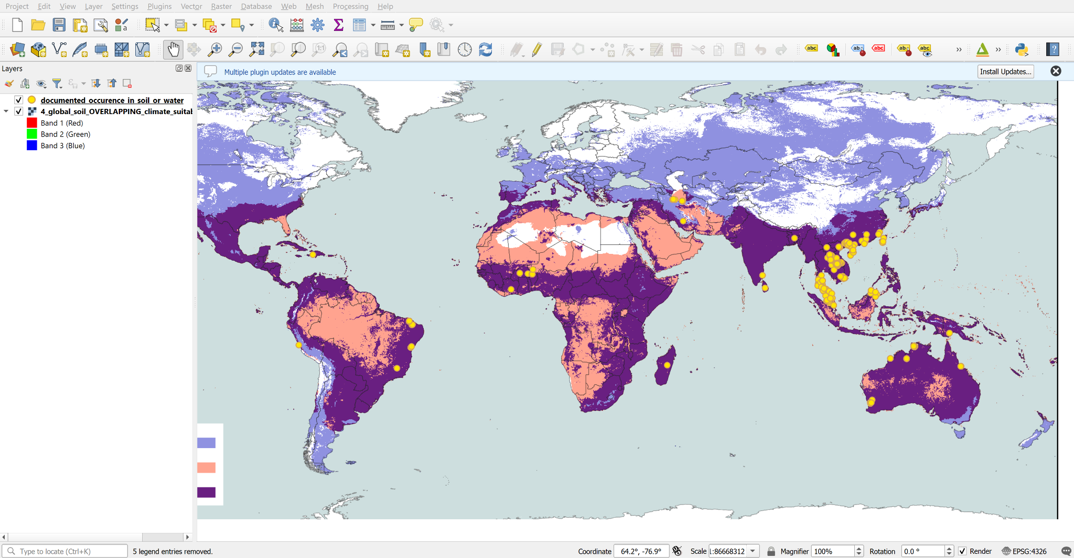


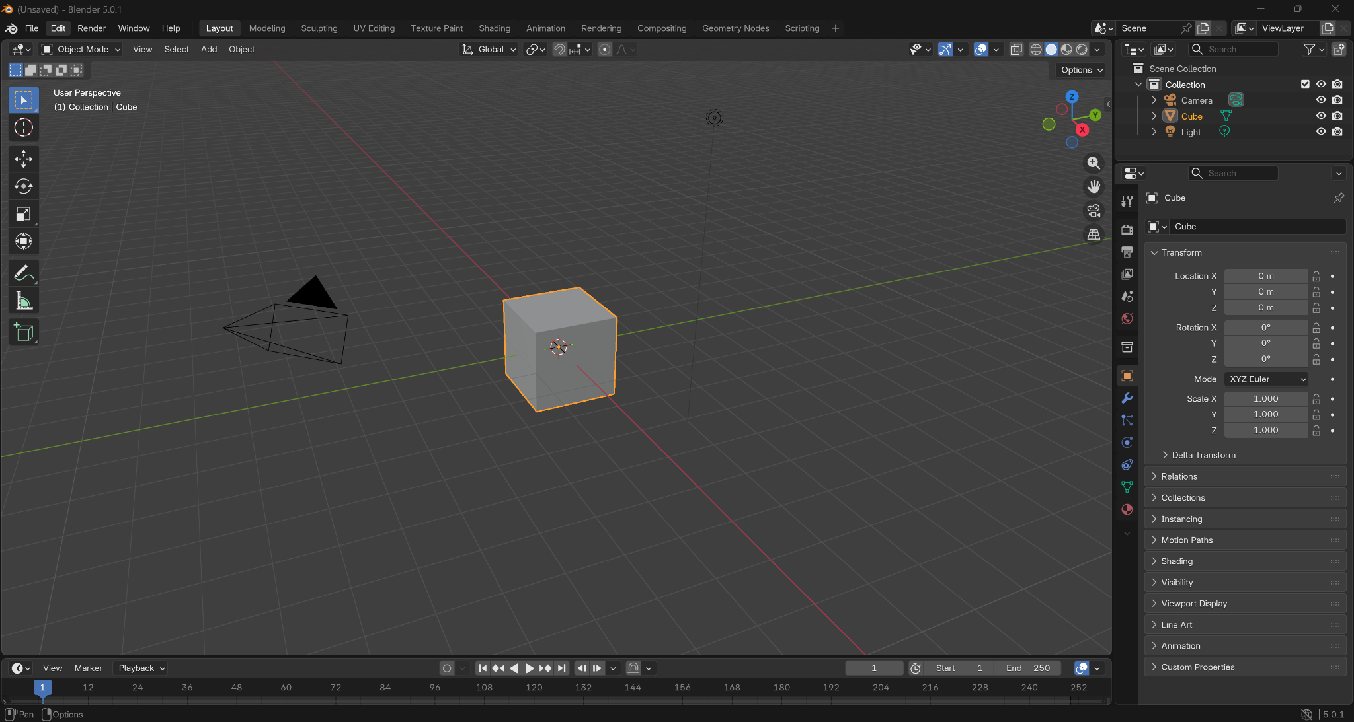
Python for Automating Processes in Data Vis Desktop Software
Software with Python APIs
Blender
ArcGIS Pro
QGIS

Slide 8
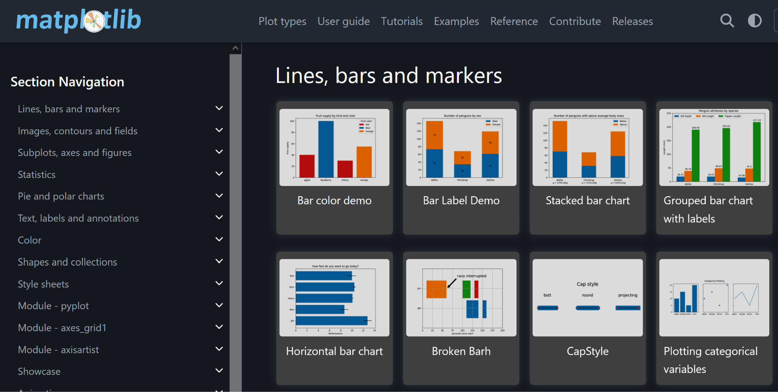
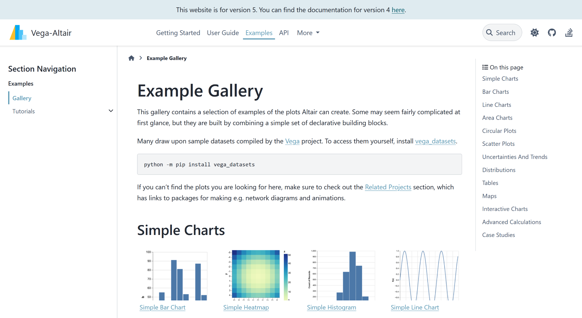
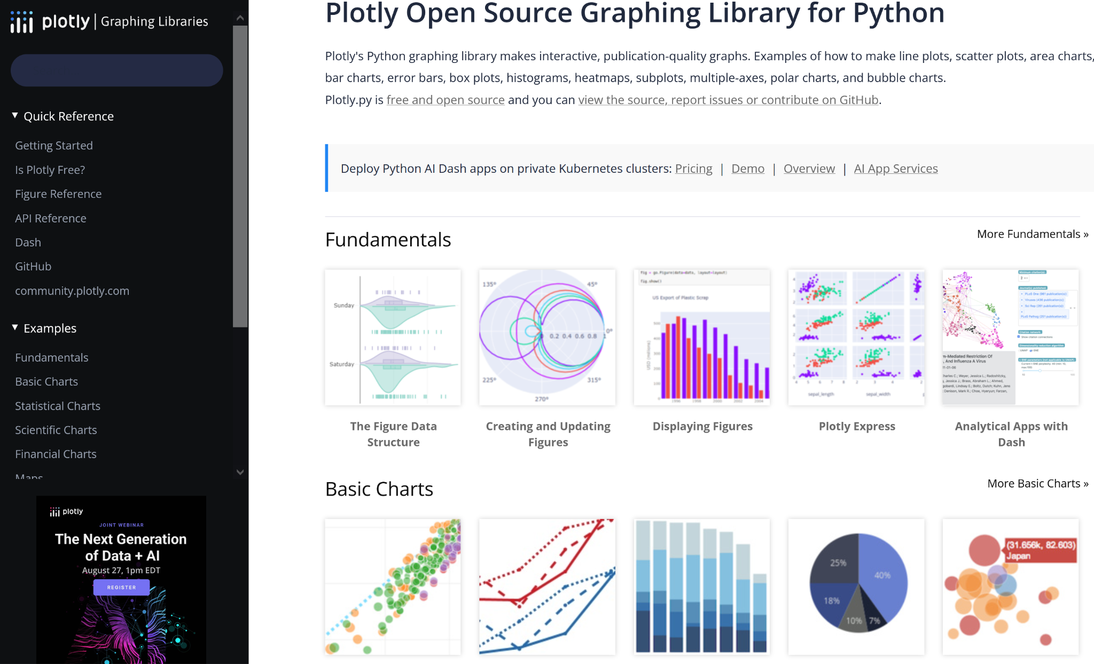
Learn What’s Possible and Get Ideas
Python Data Vis Package Galleries to Visit
NetworkX https://networkx.org/documentation/stable/auto_examples/
Plotly https://plotly.com/python/
Matplotlib https://matplotlib.org/stable/gallery/
Seaborn https://seaborn.pydata.org/examples/
Altair https://altair-viz.github.io/gallery/

Slide 9
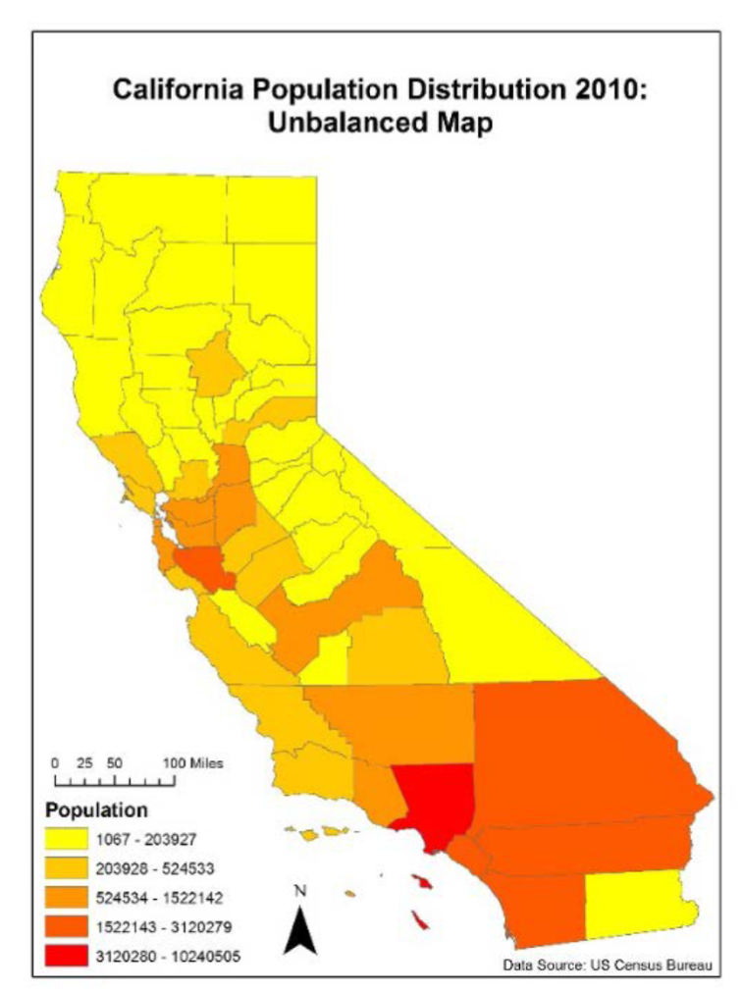
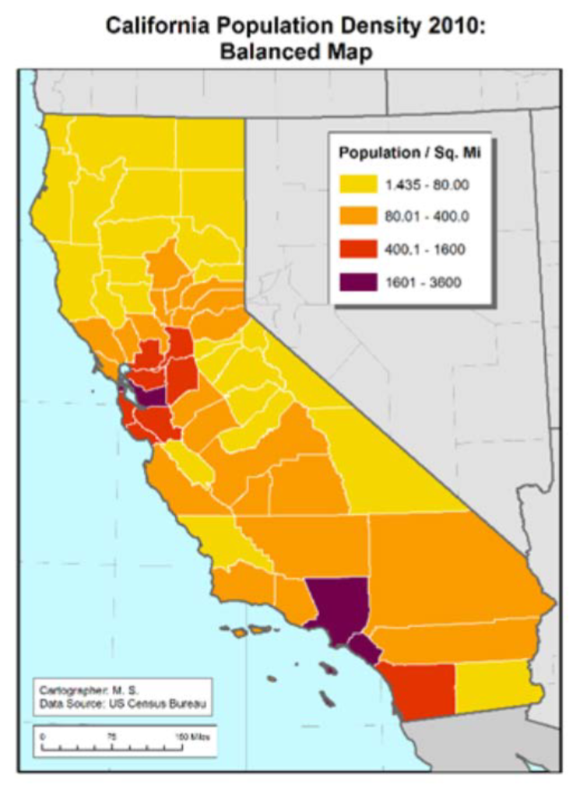
Good Data Visualization Practices
Design for your audience
Provide captions
Accessibility
Reproducibility
Consider aesthetics

Slide 10
Preparing for Data Visualization with Python
Know your data
Are there any issues with the data (errors, inconsistencies, missing values, etc.)? What can be learned from the data? How can the data be best represented in a visualization?
Process or clean data if necessary
Produce visualization
Refine visualization

Slide 11
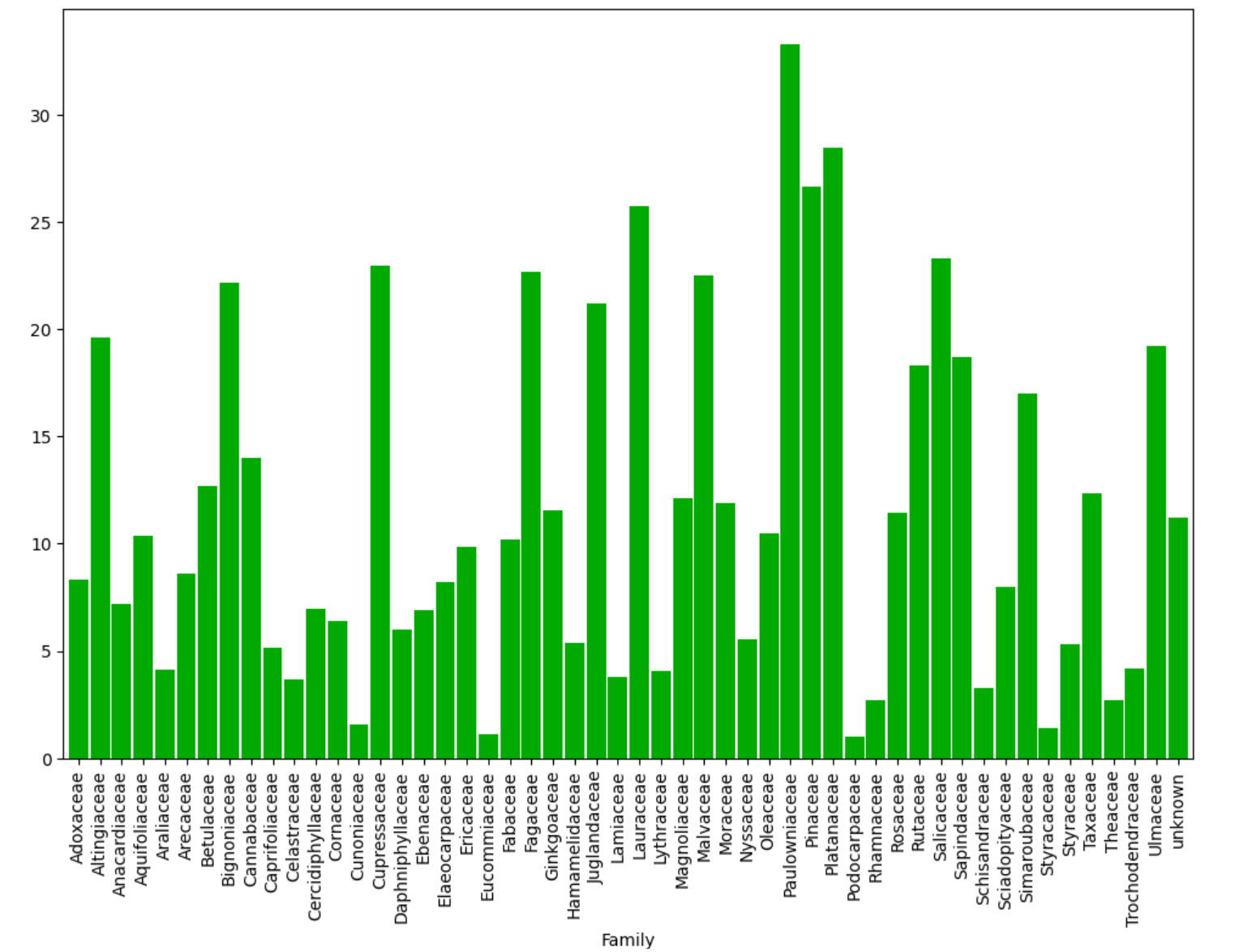
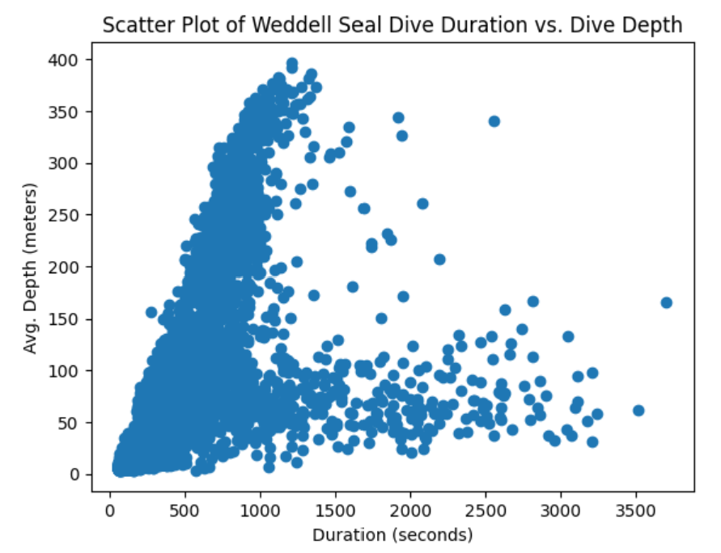
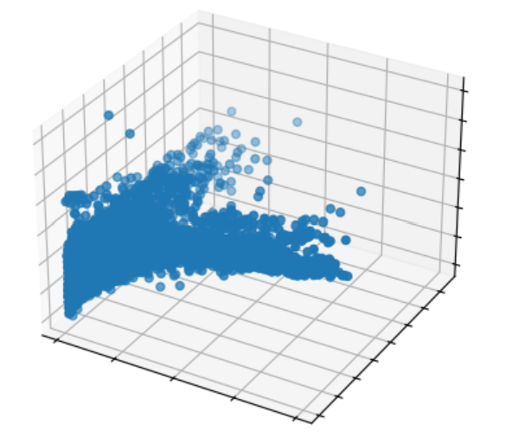
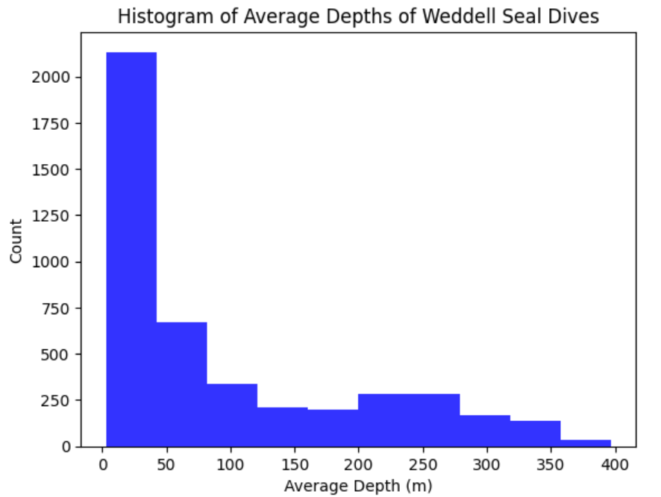
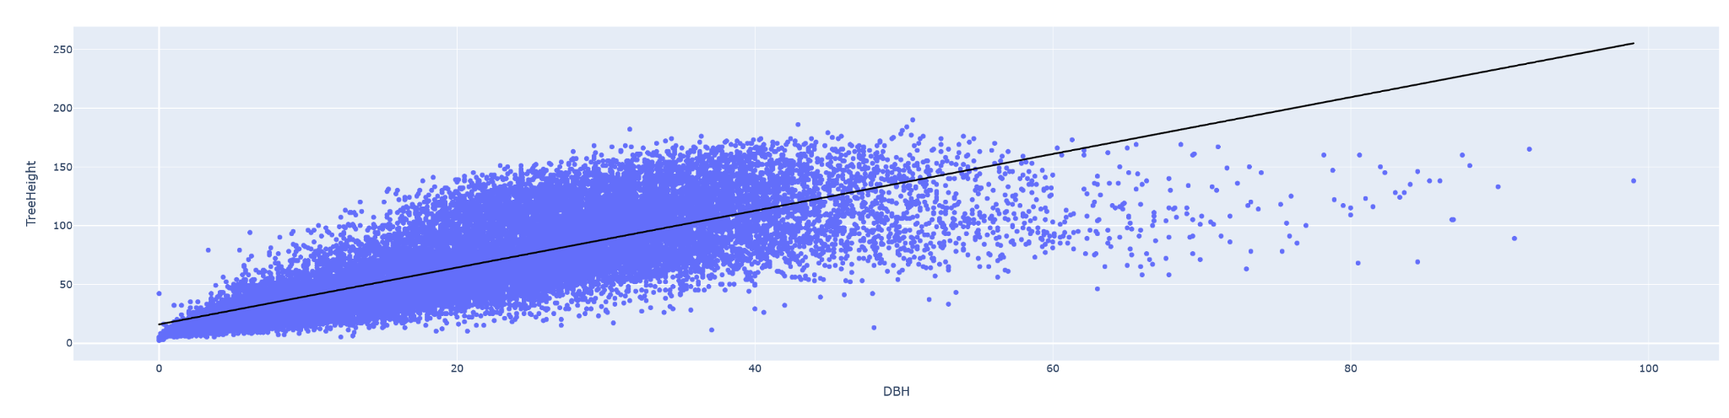
Python Demo: Visualizing Data
Installing new packages
Creating a variety of different chart types including pie charts, bar charts, and scatter plots
Comparing code for creating simple chart types with different visualization libraries
Reading package documentation to learn how to create and make adjustments to charts and figures

Slide 12
Required Packages
There are a number of required Python packages that need to be installed to successfully run the code below. Fortunately, Google Colab already has these packages installed but if you want run this code locally on your computer you would need to make sure the required packages are installed by using running the pip install command below that is correct for your operating system.
**Mac:**
python3 -m pip install numpy matplotlib pandas plotly polars rasterio requests
**Windows:**
python -m pip install numpy matplotlib pandas plotly polars rasterio requests
from matplotlib import pyplot as plt
import numpy as np
import pandas as pd
import plotly.express as px
import polars as pl
import rasterio
from rasterio.plot import show
import requests

Slide 13
Data Source: Dive characteristics of Weddell seals 2014-2016
from the Texas Data Repository dataset at https://dataverse.tdl.org/file.xhtml?fileId=62725&datasetVersionId=1894
The publication related to this dataset is: Fuiman, L.A., T.M. Williams, and R.W. Davis. 2020. Homing tactics of Weddell seals in the Antarctic fast-ice environment. Marine Biology. (doi: 10.1007/s00227-020-03730-w)
sealdivesdf = pd.read_csv("https://dataverse.tdl.org/api/access/datafile/62725?gbrecs=true")
Data Source: Portland, Oregon parks tree inventory data
From https://gis-pdx.opendata.arcgis.com/datasets/PDX::parks-tree-inventory/about
treesdf = pd.read_csv("https://hub.arcgis.com/api/v3/datasets/15ae00ece1bf486a868c0f635d3acbfa_220/downloads/data?format=csv&spatialRefId=3857&where=1%3D1")
Data Source: Telco customer churn dataset
From https://github.com/IBM/telco-customer-churn-on-icp4d/tree/master
customerchurndf = pd.read_csv("https://raw.githubusercontent.com/IBM/telco-customer-churn-on-icp4d/refs/heads/master/data/Telco-Customer-Churn.csv")

Slide 14
Data Source: Single Band Raster from UAV Imagery Orthomosaic
singleimageband2 = {"bandname":"green", "cmap":"Greens", "url":"https://ut-austin.maps.arcgis.com/sharing/rest/content/items/21bfc72d87a844c8834db572bda24e58/data"}

